Slide 1
MLCP, CoRB & MarkLogic Monitoring
Maheswari P

Slide 2
MLCP

Slide 3
MLCP
MLCP – MarkLogic Content Pump
Open source, Java based command-line tool that provides the fastest way to import, export, and copy data to or from MarkLogic databases
Core features of mlcp:
Bulk load billions of local files
Split and load large, aggregate XML files or delimited text
Bulk load billions of triples or quads from RDF files
Archive and restore database contents across environments
Export data from a database to a file system
Copy subsets of data between databases
Load documents from HDFS, including Hadoop SequenceFiles
2

Slide 4
MLCP
Supported Formats
XML, JSON, text, binary files
RDF Triples
Compressed files and archives (ZIP, GZIP)
MarkLogic archive, which includes both content and metadata (e.g., permissions and properties)
Delimited text (e.g., CSV) (import only)
Temporal Documents
Hadoop SequenceFiles
2

Slide 5
MLCP
Requirements for mlcp
MarkLogic server
MLCP download – developer.marklogic.com/products/mlcp
XDBC Server or REST API Instance
Ruby installation
JRE 1.6 or later
Modes
Local
Distributed
Operations
Import
Export
Copy
2

Slide 6
MLCP
Import command
mlcp.sh import \
-host localhost \
-port 8006 \
-username user \
-password ******* \
-input_file_path /data/latest
Export command
mlcp.sh export \
-host localhost \
-port 8006 \
-username user \
-password ******* \
-output_file_path /out/collections \
-compress true
2

Slide 7
CoRB

Slide 8
CoRB
CORB – COntent Reprocessing in Bulk
Open Source Java tool designed for bulk content-reprocessing of documents stored in MarkLogic
Batch processing in multiple threads
Core features of CORB:
Bulk content-reprocessing
Generating a report across all documents
Manipulating the individual documents or a combination
Performing bulk data transforms
2

Slide 9
CoRB
Requirements for CORB
MarkLogic server
Corb2 Jar
MarkLogic XCC Jar
XDBC Server
JRE 1.6 or later
Modes
Single Threaded
Multi Threaded
2

Slide 10
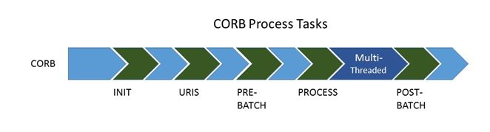
CoRB
CORB TASKS
INIT
URIS
PRE-BATCH
PROCESS
POST-BATCH
1. INIT
For initialization services
Single Threaded mode
Can be run through custom java class or XQuery
2

Slide 11
CoRB
2. URIS
Single Threaded mode
Can be placed in MarkLogic Modules DB or Native Location (ADHOC)
The URIS task specifies the documents to be used by the Transform task
Document URIs can be pulled from an input file or by an XQuery module (Selector Module)
Can pass optional arbitrary string to Xquery modules in next stages (PRE-BATCH / PROCESS / POST-BATCH) as an external variable (Eg: Dynamic File Name)
Not necessarily be URIs but also can be strings.
Output sent to PROCESS TASK one at a time (One URI at a time)
2

Slide 12
CoRB
3. PRE-BATCH
Single Threaded mode
By a custom Java task and/or an XQuery module before the PROCESS task
Most common use case – Creating HEADER for the output file
PRE-BATCH-MODULE – For Dynamic Values
PRE-BATCH-TASK – For reading the output from PRE-BATCH-MODULE, reading static headers
PRE-BATCH-MODULE=uri/for/prebatch.xqy
PRE-BATCH-TASK=com.marklogic.developer.PreBatchUpdateFileTask
EXPORT-FILE-NAME=nameOfFileWhichWillContainTheReport.txt
EXPORT-FILE-DIR=path/Of/Directory/ExportFileName/Resides/In/If/Not/ProvidedInName
EXPORT-FILE-TOP-CONTENT=name of column1, name of column2, name of column3, etc.
2

Slide 13
CoRB
4. PROCESS
MULTI Threaded mode to split the documents amongst threads – Workhorse of CORB
Input from URI Task (Iterated over all the URIs)
Xquery/JavaScript module as Transform module – URI as External variable from URI task
Output can be formatted to CSV/XML/JSON
Extracts will be placed at destination location
PROCESS-MODULE=/path/to/transform.xqy
THREAD-COUNT=16
PROCESS-TASK=com.marklogic.developer.corb.ExportBatchToFileTask
2

Slide 14
CoRB
5. POST-BATCH
Single Threaded
Can be used to perform a cleanup task, call a query or write footers to a batch report
POST-BATCH-MODULE – For Dynamic Values
POST-BATCH-TASK – For reading the output from POST-BATCH-MODULE, reading static footers, etc.,
POST-BATCH-MODULE=/path/to/postBatch.xqy
POST-BATCH-TASK=com.marklogic.developer.corb.PostBatchUpdateFileTask
EXPORT-FILE-BOTTOM-CONTENT=footerName1,footerName2,footerName3
EXPORT_FILE_AS_ZIP=true
2

Slide 15
MarkLogic Monitoring

Slide 16
Why do we need monitoring?
For initial capacity planning and fine-tuning your MarkLogic Server environment.
To keep track of the day-to-day operations of your MarkLogic Server environment in real time.​
To capture historical performance metrics.​
To troubleshoot application performance problems.
To troubleshoot application errors and failures.​
2

Slide 17
MarkLogic Monitoring tools
Management API - Can be used to integrate MarkLogic Server with existing monitoring application or to create custom monitoring applications.
Monitoring Dashboard - Monitors MarkLogic Server in Real-time.
Monitoring History - Capture and make use of historical performance data for a MarkLogic cluster.
MarkLogic Telemetry
Splunk (External)
2

Slide 18
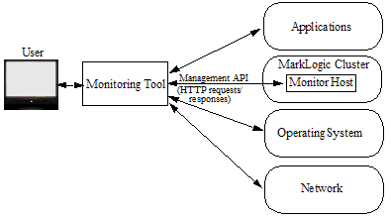
MarkLogic Monitoring
2

Slide 19
“manage-user” role
To gain access to the ML monitoring features, user must be assigned the “manage-user” role.
Provides access to the Management API, Manage App Server, and the UI for the Configuration Manager and Monitoring Dashboard.
Provides read-only access to all of a cluster's configuration and status information.
2

Slide 20
5. Splunk - External Monitoring Tool
Configurable with MarkLogic Server
Export the logs related to MarkLogic Server objects and processes, such as hosts, databases, forests, App Servers, groups, transactions, and requests.
Export application specific logs (info,error,debug)
Export Corb/MLCP logs
Can setup a metered Corb job to export the logs to Splunk
2

Slide 21
Added Benefits (ML+Splunk)
Access older logs
Access at a single place
Search through the history
Build user defined queries
Generate & Export reports
Performance analysis
Email alerting mechanism – configuration
2

Slide 22
5. Splunk - External Monitoring Tool
Configurable with MarkLogic Server
Export the logs related to MarkLogic Server objects and processes, such as hosts, databases, forests, App Servers, groups, transactions, and requests.
Export application specific logs (info,error,debug)
Export Corb/MLCP logs
Can setup a metered Corb job to export the logs to Splunk
2

Slide 23
APPENDIX

Slide 24
MLCP Terms & Definitions
Term | Definition
aggregate | XML content that includes recurring element names and which can be split into multiple documents with the recurring element as the document root.
line-delimited JSON | A type of aggregate input where each line in the file is a piece of standalone JSON content. For details, see Creating Documents from Line-Delimited JSON Files.
archive | A compressed MarkLogic Server database archive created using the mlcp export command. You can use an archive to restore or copy database content and metadata with the mlcp import command. For details, see Exporting to an Archive.
HDFS | The Hadoop Distributed File System, which can be used as an input source or an output destination in distributed mode.
sequence file | A flat file of binary key-value pairs in one of the Apache Hadoop SequenceFile formats. The mlcp tool only supports importing Text and BytesWritable values from a sequence file.
split | The unit of work for one thread in local mode or one MapReduce task in distributed mode.
2

Slide 25
Input Source | Default URI | Example
documents in a native or HDFS directory | /path/filename Note that on Windows, the device ('c:') becomes a path step, so c:\path\file becomes /c:/path/file. | /space/data/bill/dream.xml /c:/data/bill/dream.xml
documents in a ZIP or GZIP file | /compressed-file-path/path/inside/zip/filename | If the input file is /space/data/big.zip and it contains a directory entry bill/, then the document URI for dream.xml in that directory is: /space/data/big.zip/bill/dream.xml
a GZIP compressed document | /path/filename-without-gzip-suffix | If the input is /space/data/big.xml.gz, the result is /space/data/big.xml.
delimited text file | The value in the column used as the id. (The first column, by default). | For a record of the form 'first,second,third' where Column 1 is the id: first
archive or forest | The document URI from the source database.
sequence file | The key in a key-value pair
aggregate XML line delimited JSON | /path/filename-split_start-seqnum Where /path/filename is the full path to the input file, split_start is the byte position from the beginning of the split, and seqnum begins with 1 and increments for each document created. | For input file /space/data/big.xml: /space/data/big.xml-0-1 /space/data/big.xml-0-2 For input file /space/data/big.json: /space/data/big.json-0-1 /space/data/big.json-0-2
RDF | A generated unique name | c7f92bccb4e2bfdc-0-100.xml
2

Slide 26
Loading a single File from a directory
mlcp.sh import -host localhost -port 8006 -username user \ -password password
-input_file_path /space/bill/data/hamlet.xml
Loading All the Files in a Directory
mlcp.sh import -host localhost -port 8006 -username user \ -password password
-input_file_path /space/bill/data
Filtering Documents Loaded From a Directory
mlcp.sh import -host localhost -port 8006 -username user \ -password password -input_file_path /space/bill/data \ -mode local -input_file_pattern '.*\.xml'
2

Slide 27
Loading Documents From Compressed Files
mlcp.sh import -host localhost -port 8006 -username user \ -password password -mode local -document_type binary \ -input_file_path /space/images.zip -input_compressed
mlcp.sh import -host localhost -port 8006 -username user \ -password passwd -mode local -input_file_path /space/example.jar \ -input_compressed true -input_compression_codec zip
Loading Content and Metadata From an Archive
mlcp.sh import -host localhost -port 8006 -username user \ -password password -mode local -input_file_type archive \ -input_file_path /space/archive_dir
2

Slide 28
Transforming the Default URI
Use the following options to tailor the database URI of inserted documents:
-output_uri_replace performs one or more string substitutions on the default URI.
-output_uri_prefix prepends a string to the URI after substitution.
-output_uri_suffix appends a string to the URI after substitution
Input Filename | URI Options | Output URI | Doc Type
/path/doc.1 | None | /path/file.1 | binary
/path/doc.1 | Add a .xml suffix: -output_uri_suffix ".xml" | /path/file.xml | XML
/path/doc.1 | Replace the unmapped suffix with .txt: -output_uri_replace "\.\d+,'.txt'" | /path/file.txt | text
2

Slide 29
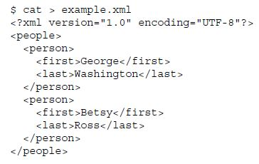
Splitting Large XML Files Into Multiple Documents
mlcp.sh import -host localhost -port 8006 -username user \
-password password -mode local -input_file_path example.xml \ -input_file_type aggregates \
-aggregate_record_element person \
-uri_id last
-output_uri_prefix /people/ \
-output_uri_suffix .xml
2

Slide 30
XML and JSON Output
$ cat example.csv
first, last
George, Washington
betsy,ross
$ mlcp.sh ... -mode local -input_file_path /space/mlcp/data \
-input_file_type delimited_text ...
Then mlcp creates the XML output shown in the table below.
To generate the JSON output, add -document_type json to the mlcp command line.
XML Output | JSON Output
<root> <first>george</first> <last>washington</last> </root> <root> <first>betsy</first> <last>ross</last> </root> | { "first": "george", "last": "washington" } { "first": "betsy", "last": "ross" }
2

Slide 31
The following example produces documents with root element <person> in the namespace http://my.namespace.
Source:
first,last
george,washington
betsy,ross
MLCP Command:
$ mlcp.sh ... -mode local -input_file_path /space/mlcp/data \
-input_file_type delimited_text -namespace http://my.namespace \
-delimited_root_name person
Output:
<person xmlns="http://my.namespace">
<first>george</first>
<last>washington</last>
</person>
2

Slide 32
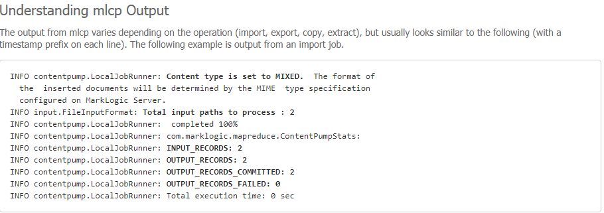
2

Slide 33
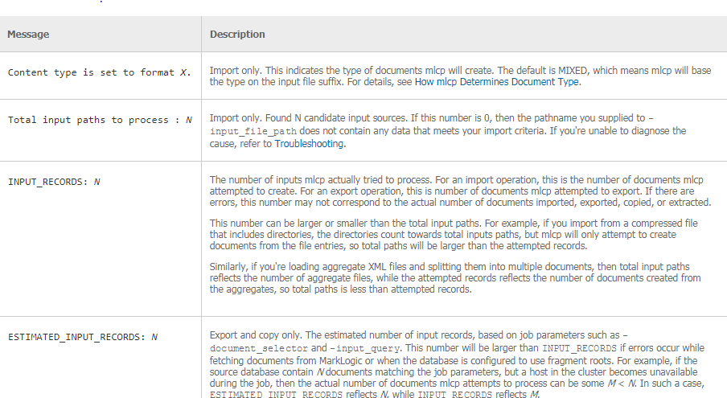
2

Slide 34
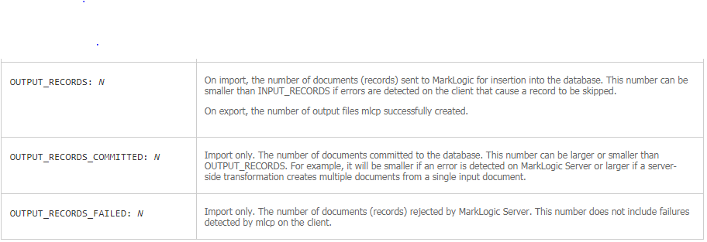
2

Slide 35
Transforming Content During Ingestion
Creating a Custom Transformation
Installing a Custom Transformation
Using a Custom Transformation
If the input document is XML, insert @NEWATTR, with the value : specified in the input parameter. If the input document is not : XML, leave it as-is.
2

Slide 36
1. Creating a Custom Transformation
xquery version "1.0-ml";
module namespace example = "http://marklogic.com/example";
declare function example:transform(
$content as map:map,
$context as map:map
) as map:map*{
let $attr-value :=
(map:get($context, "transform_param"), "UNDEFINED")[1]
let $the-doc := map:get($content, "value")
return
if (fn:empty($the-doc/element()))
then $content
else
let $root := $the-doc/*
return (
map:put($content, "value",
document {
$root/preceding-sibling::node(),
element {fn:name($root)} {
attribute { fn:QName("", "attr1") } {$attr-value},
$root/@*,
$root/node()
},
$root/following-sibling::node()
}
), $content
)
};

Slide 37
2. Installing a Custom Transformation
xquery version "1.0-ml";
xdmp:document-load("D:/MLCP_Data/transform.xqy",
<options xmlns="xdmp:document-load">
<uri>/example/mlcp-transform.xqy</uri>
<repair>none</repair>
<permissions>{xdmp:default-permissions()}</permissions>
</options>)
3. Using a Custom Transformation
mlcp.bat import -host localhost -port 8006 -username admin ^
-password admin -input_file_path /MLCP_Data/data -mode local ^
-transform_module /example/mlcp-transform.xqy ^
-transform_namespace "http://marklogic.com/example" ^
-transform_param "my-attribute"
37

Slide 38
Exporting Content from MarkLogic Server
Exporting Documents as Files
Select the files to export
To select documents in one or more collections, set -collection_filter to a comma
separated list of collection URIs.
To select documents in one or more database directories, set -directory_filter to a
comma separated list of directory URIs.
To select documents matching an XPath expression, use -document_selector.
To select all documents in the database, leave -collection_filter, -directory_filter, and –
document_selector unset.
2. Set -output_file_path to the destination file or directory on the native
filesystem or HDFS.
3. To prettyprint exported XML when using local mode, set -indented to true.
38

Slide 39
The following example exports selected documents in the database to the native filesystem directory /space/mlcp/export/files. The directory filter selects only the documents in /plays.
$ mlcp.sh export -host localhost -port 8006 -username user \ -password password -mode local -output_file_path \ /space/mlcp/export/files -directory_filter /plays/
Exporting Documents to a Compressed File
mlcp.sh export -host localhost -port 8006 -username user \ -password password -mode local \ -output_file_path /space/examples/export -compress true
Exporting to an Archive
$ mlcp.sh export -host localhost -port 8006 -username user \ -password password -mode local \ -output_file_path /space/examples/exported -output_type archive \ -copy_permissions false -directory_filter /plays/
39

Slide 40
Copying Content Between Databases
The following example copies selected documents, excluding the source permissions and adding the documents to 2 new collections in the destination database
$ mlcp.sh copy -mode local -input_host srchost -input_port 8006 \
-input_username user1 -input_password password1 \
-output_host desthost -output_port 8010 -output_username user2 \
-output_password password2 -copy_permissions false \
-output_collections shakespeare,plays
40

Slide 41
Resources
https://github.com/marklogic/marklogic-contentpump
https://developer.marklogic.com/products/mlcp
https://github.com/marklogic-community/corb2/wiki
https://github.com/marklogic-community/corb2/wiki/CORB-Stages
https://github.com/marklogic-community/corb2
https://docs.marklogic.com/guide/monitoring
https://docs.marklogic.com/guide/concepts/admin-monitoring
2

Slide 42
Thank You
Cognizant MarkLogic CoE DL → BigDataMarklogicCOE@cognizant.com

